Slide 1
Agile Process Models
Mr. D. Yakobu, Asst. Professor, Dept. of Comp. Science & Engg., VFSTR Deemed to be University

Slide 2
Agile Process Models
What is Agility???
Principles of Agile process models???
What is an Agile Process Model???
Human Factor of APM?
Xtreme Programming?
Scrum?

Slide 3
Agility???
Agility: Moving quickly/easily
From software Engineering perspective, it is an “effective response to change”.
It is more than that, couples the Phylosaphy and development guidelines.

Slide 4
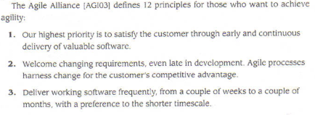
Principles…

Slide 5
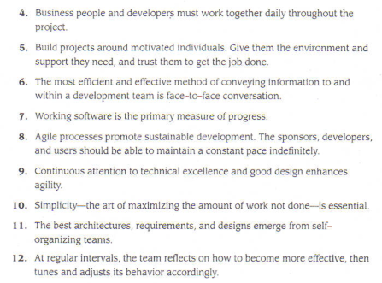
Principles cont…

Slide 6
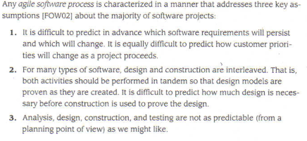
What is an Agile Process Model???

Slide 7
Human Factors???
Competence
Common focus
Collaboration
Decision making ability
Fuzzy problem solving ability
Mutual trust and respect
Self organizing

Slide 8
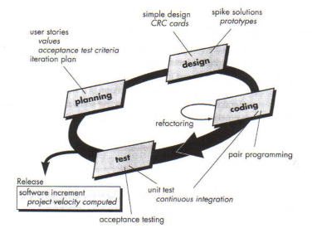
Xtreme Programming

Slide 9
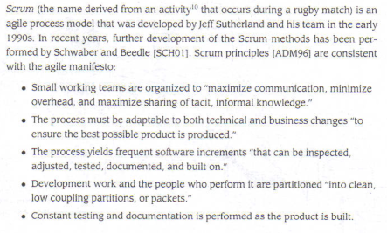
Scrum

Slide 10
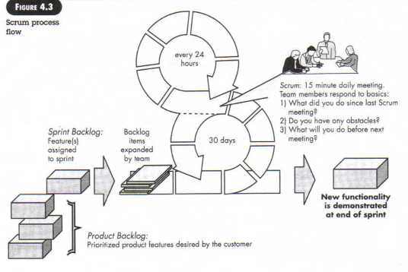
Scrum cont…

Slide 11
Thank You

